Slide 1
Image Analysis in CyVerse
Blake Joyce
Science Informatician
University of Arizona

Slide 2

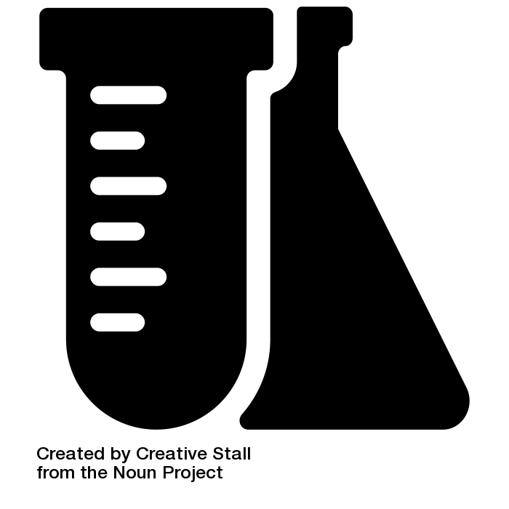
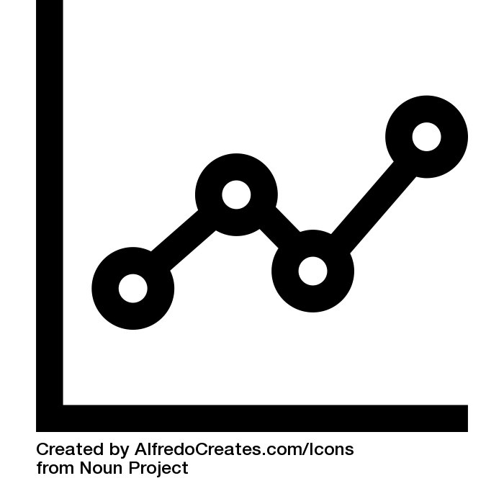
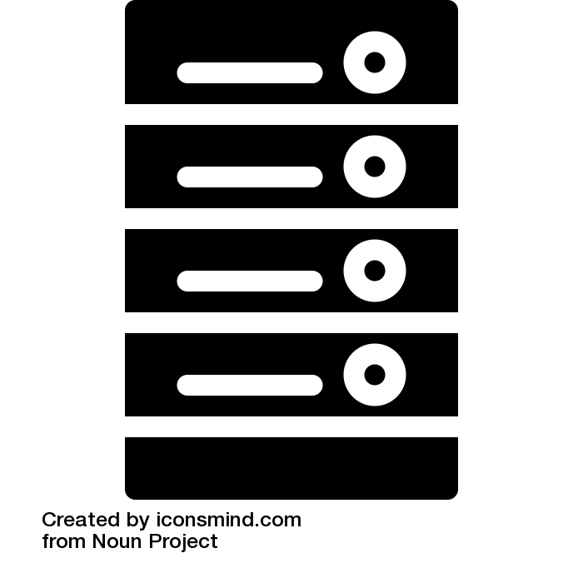

1,601
3,735
51,541
Participating Non-Academic Institutions
Participating Academic Institutions
Users
Labs
Data
Analysis
People
Labs and universities collect data
Data is analyzed by high power computing
Data is accessed by people anywhere in the world

Slide 3
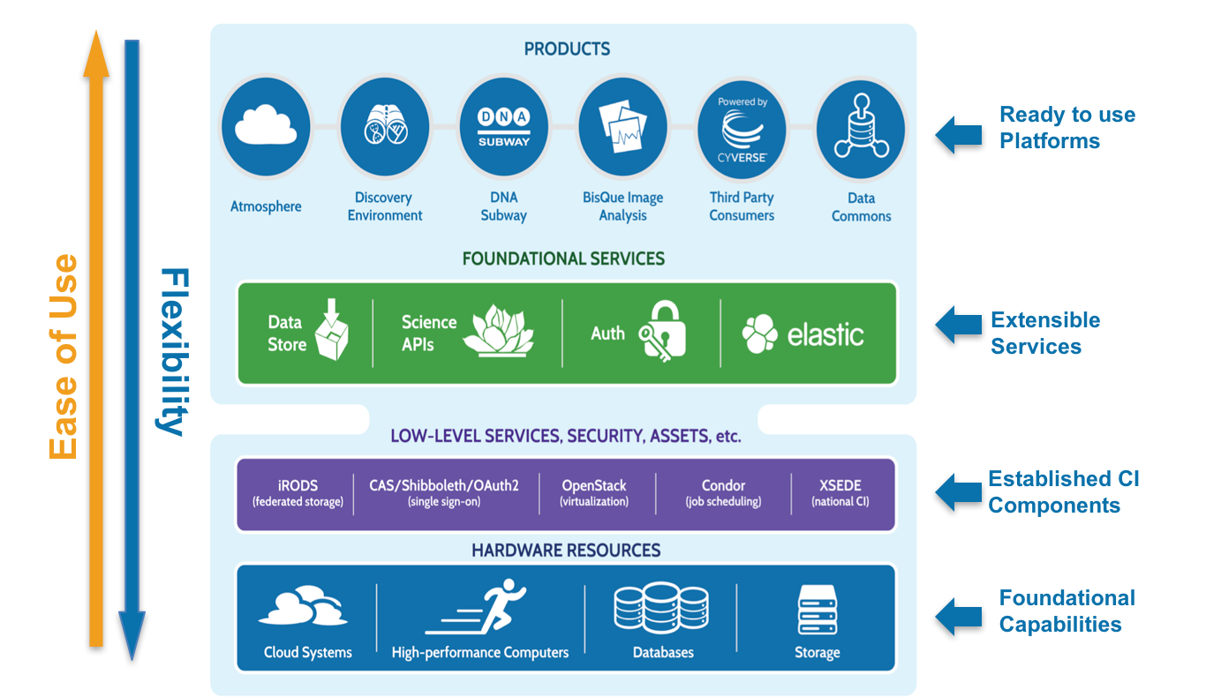

Slide 4
Initial Users and Developers

Slide 5
The Genomes to Fields Initiative
This public-private partnership to develop approaches to understand the functions of corn genes and specific alleles across environments.
Ultimately this information will be used to improve our ability to predict crop performance in diverse environments.
Experts in genetics, genomics, plant physiology, agronomy, climatology and crop modeling, with computation and informatics, statistics and engineering working together.
Notes:
Note: I highlighted the text win underline in middle panel
Remember the venn diagram I had shown you, we are improving the overlap
Touch upon crowd sourcing and Luis Von Han

Slide 6
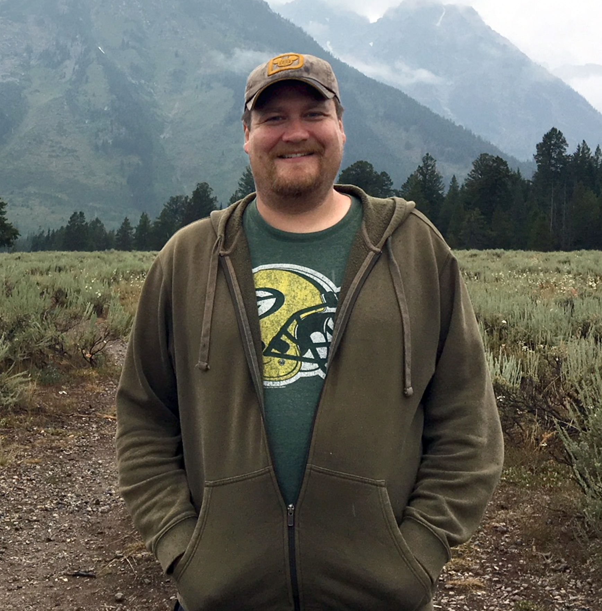
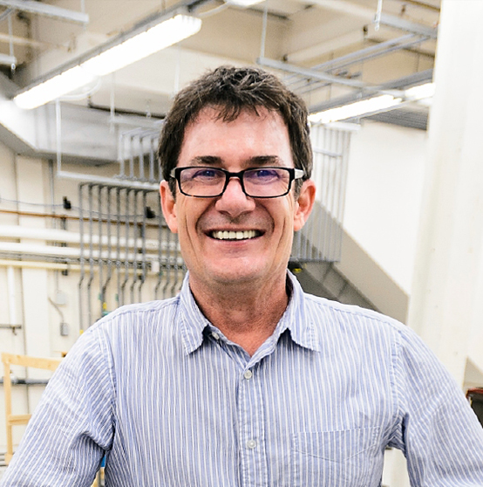
Data to Information to Knowledge Team
This is Nate Miller
Nathan Miller
University of Wisconsin
Celeste Falcon
University of Wisconsin
Edgar Spalding
University of Wisconsin
Notes:
This is Nate Miller, he is biomedical engineer that is a expert in computer vision.
Nate hands crafts amazing algorithms for complex tasks for plant biologists that are completely crushed by the throughput of data.
Nate is a human unicorn in this line of work. I always mention to people, CyVerse is not in the business of scaling computation and data systems, those are solved problems ..you can go buy the systems/capacity. We are in the business of scaling people like Nate. Every time someone sees what he has created they want to replicate it and customize it. How can we allow Nate to support the scientific endeavors of multiple groups ? It is through open science, open innovation and open data. Let me show you more
Ear, Cob and Kernel Room Setup at Wisconsin Crop Innovation Center

Slide 7
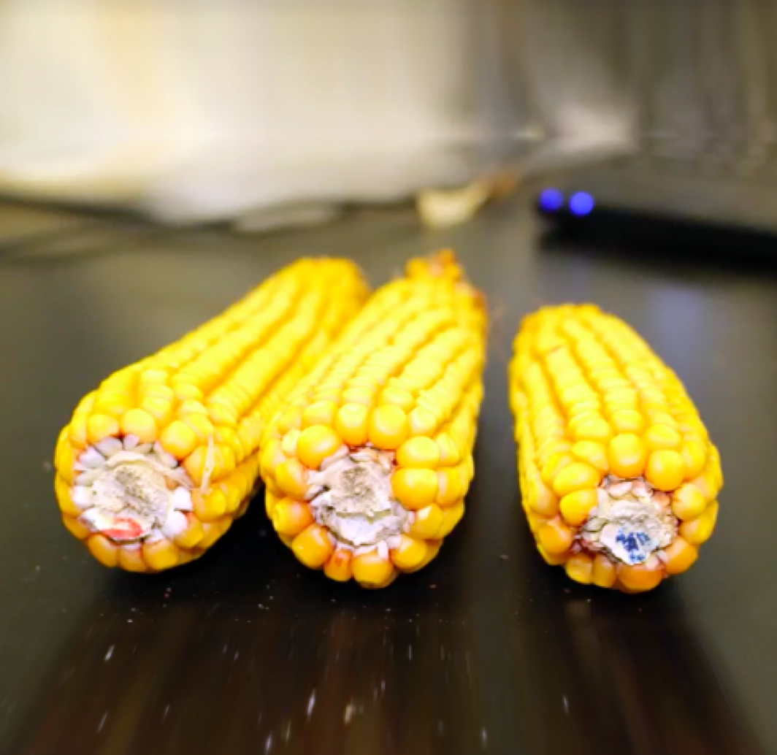
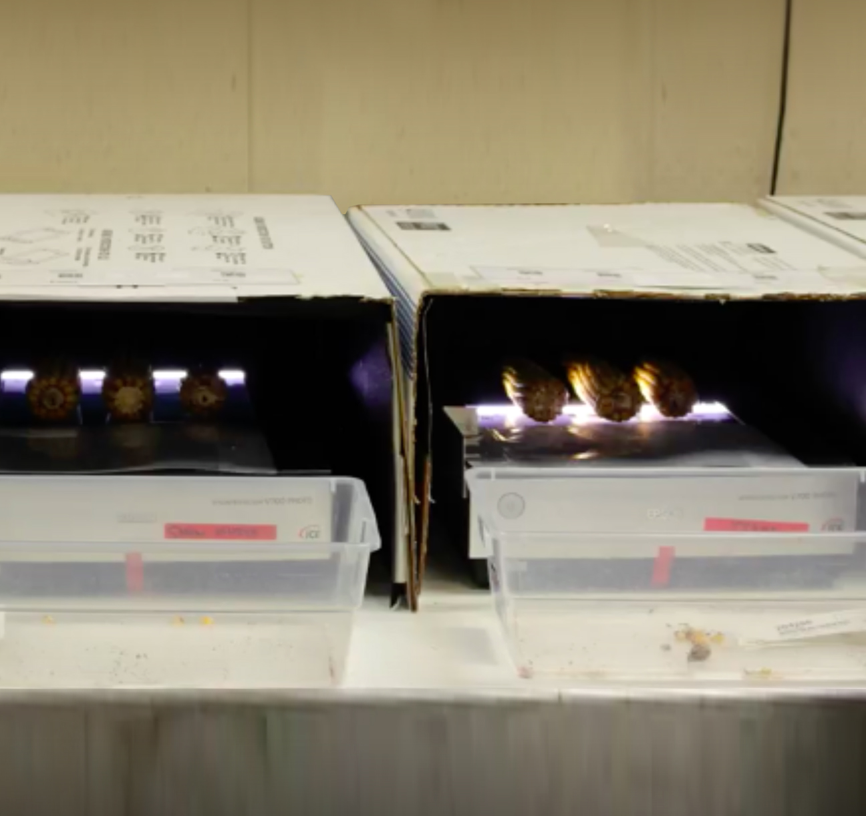
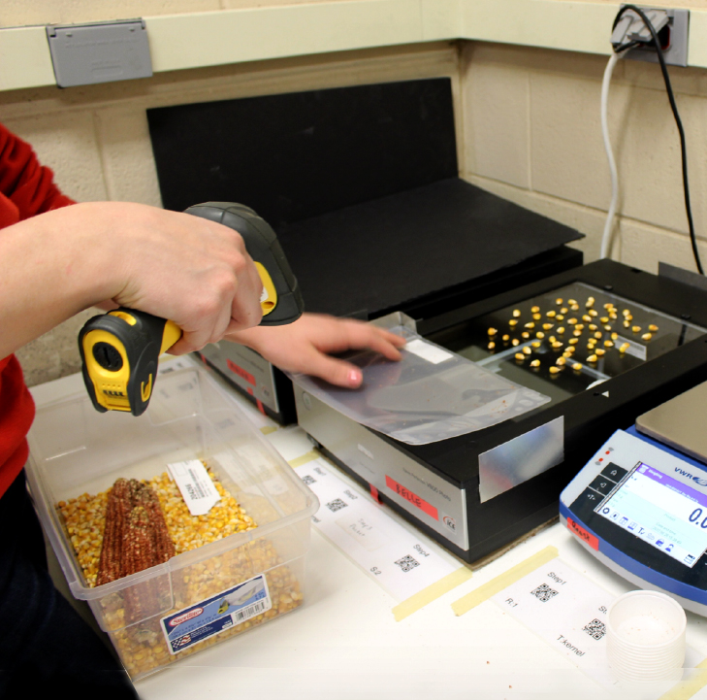
Getting Data: processing corn
This is Nate Miller
Wisconsin Crop Innovation Center Ear, Cob & Kernel Room
Copy appears here
Notes:
This is Nate Miller, he is biomedical engineer that is a expert in computer vision.
Nate hands crafts amazing algorithms for complex tasks for plant biologists that are completely crushed by the throughput of data.
Nate is a human unicorn in this line of work. I always mention to people, CyVerse is not in the business of scaling computation and data systems, those are solved problems ..you can go buy the systems/capacity. We are in the business of scaling people like Nate. Every time someone sees what he has created they want to replicate it and customize it. How can we allow Nate to support the scientific endeavors of multiple groups ? It is through open science, open innovation and open data. Let me show you more
Ear, Cob and Kernel Room Setup at Wisconsin Crop Innovation Center

Slide 8

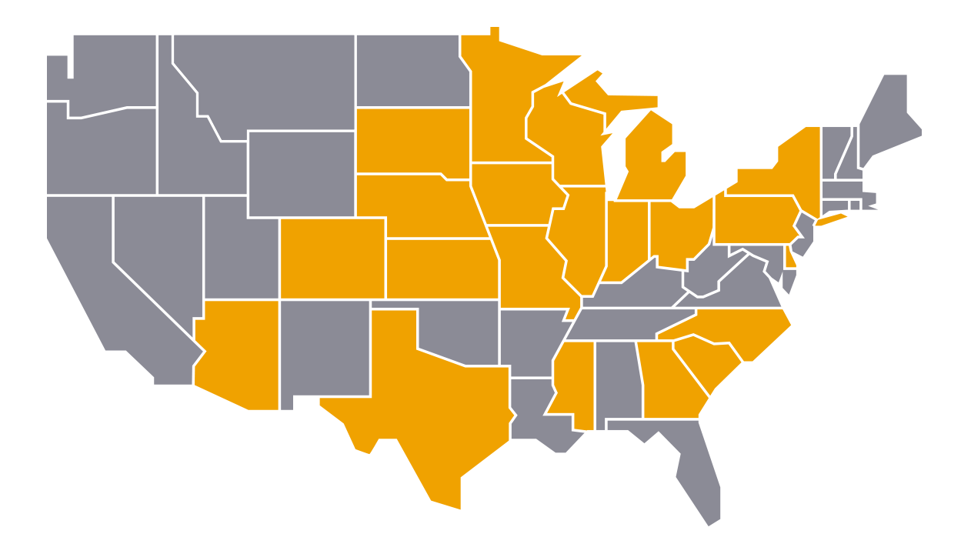

From data to information
Cyberinfrastructure: The Invisible Platform
This is Nate Miller
CyVerse
Open Science
Grid
Notes:
Terabytes from all of these sites flow to CyVerse regularly, users then connect to Cyverse and launch the analysis developed by Nathan and it uses 1000 of computers at OSG and analyze this was amounts of data into synthesized information

Slide 9
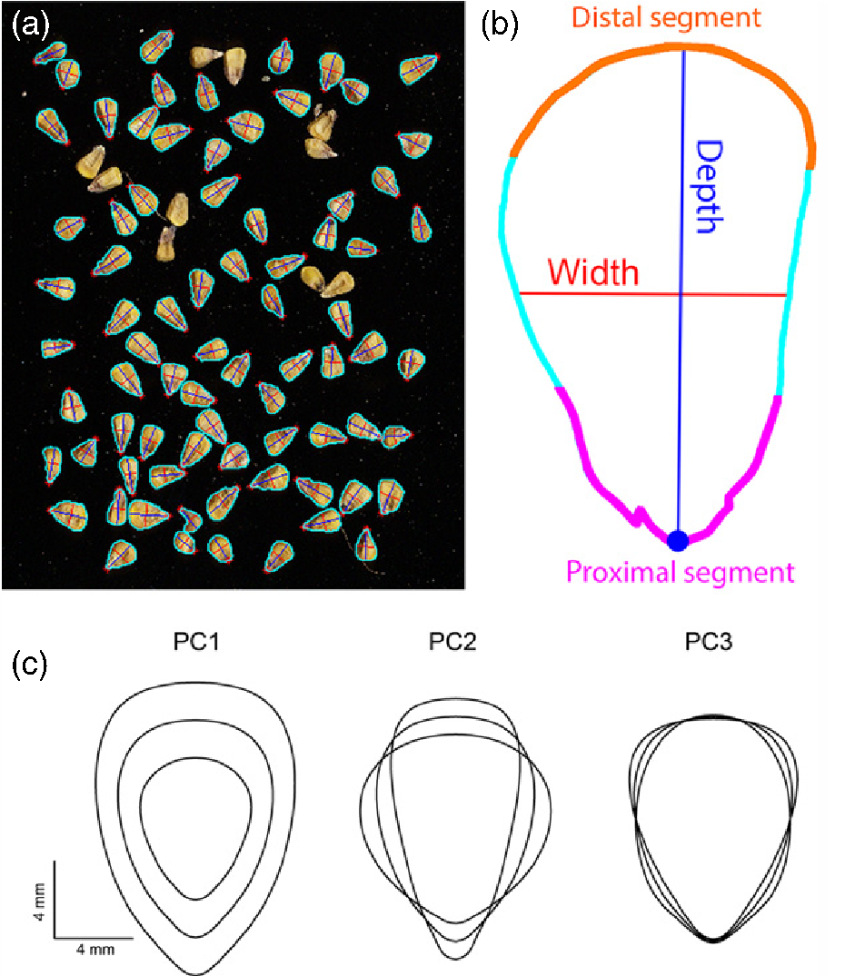
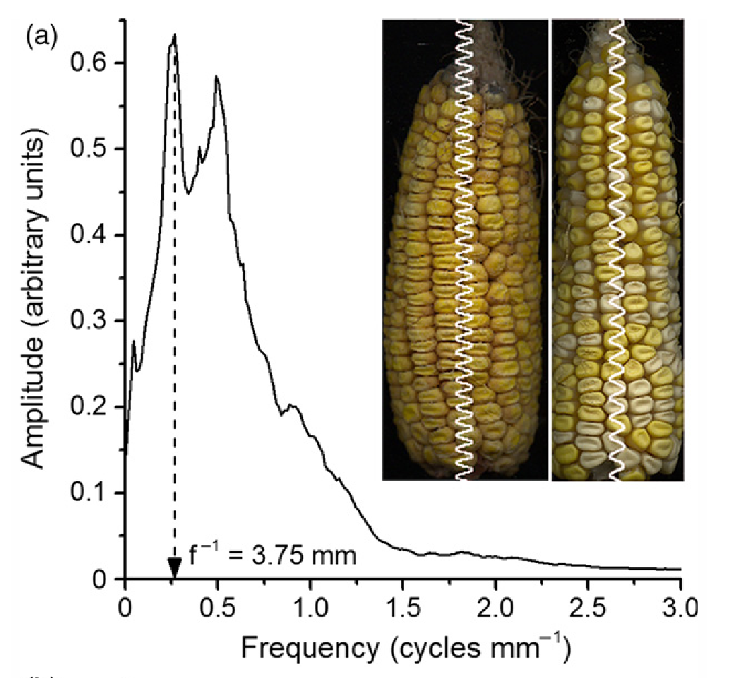
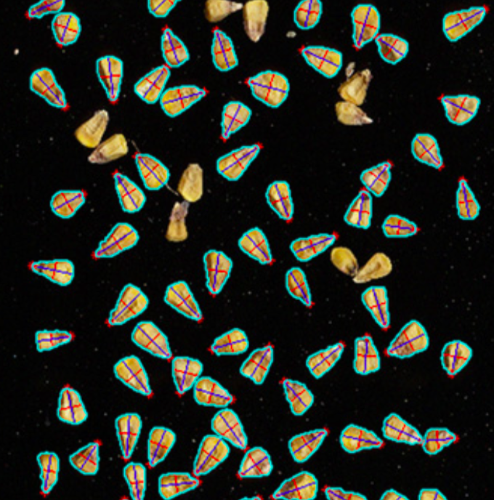
Novel ways to describe data
Multiple Genomes
Notes:
This is machine learning based vision system built by Nate that makes all the normal hand measurements that were done on each kernel. If you want to appreciate the time it saves think of a vernier caliper and data entry involved

Slide 10
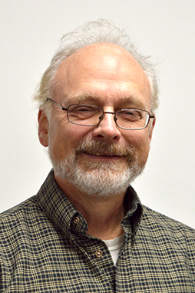

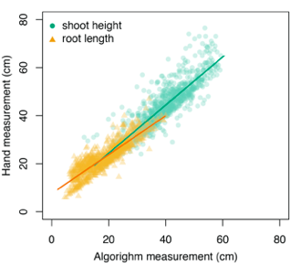
Carrot Phenomics
This is Nate Miller
Hand Measurement (cm)
Phillip Simon
University of Wisconsin
Sarah Turner
University of Missouri
Algorithm Measurement (cm)
Coming Soon: beets and onions!
Notes:
Paper coming soon

Slide 11
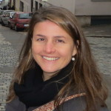

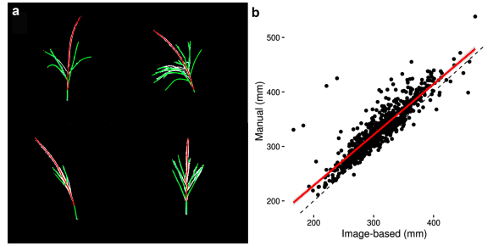
Maize Tassels: machine vision
This is Nate Miller
Natalia de Leon
University of Wisconsin
Joe Gage
University of Missouri
Gage, Joseph L., et al. "TIPS: a system for automated image-based phenotyping of maize tassels." Plant methods 13.1 (2017): 21.
Notes:
Reference: Gage, Joseph L., et al. "TIPS: a system for automated image-based phenotyping of maize tassels." Plant methods 13.1 (2017): 21.

Slide 12
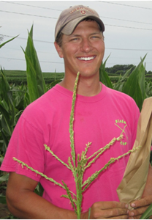
Maize Ear, Cob, and Kernel
This is Nate Miller
Natalia de Leon
University of Wisconsin
Nick Haase
PIONEER
Miller, Nathan D., et al. "A robust, high‐throughput method for computing maize ear, cob, and kernel attributes automatically from images." The Plant Journal 89.1 (2017): 169-178.
Notes:
Paper coming soon

Slide 13

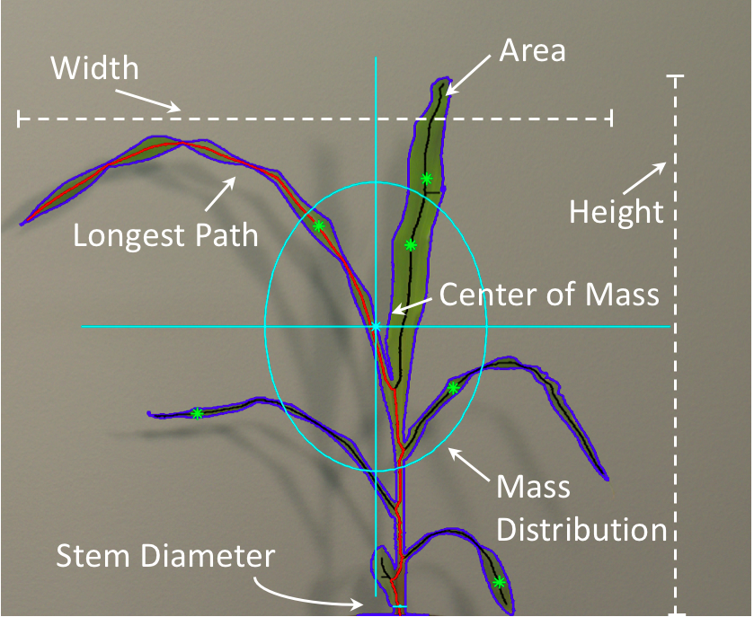
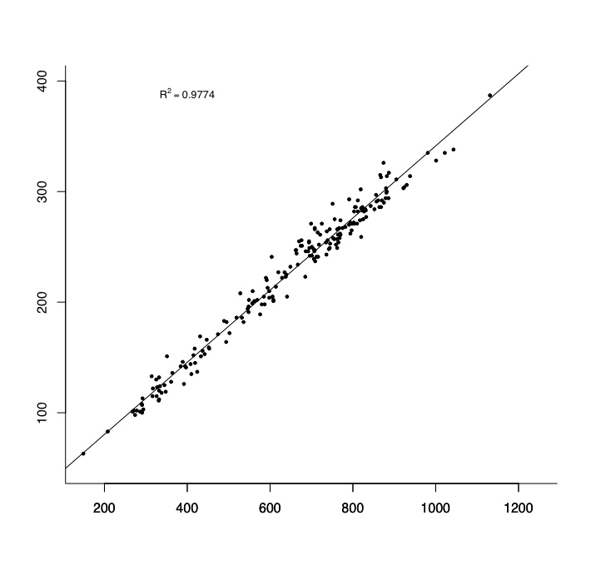
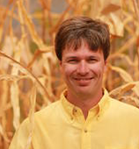
Maize Architecture Pipeline
This is Nate Miller
Hand Measurement (cm)
Cory Hirsch
University of Minnesota
Algorithm Measurement (cm)
Nathan Springer
University of Wisconsin
Notes:
Postdoc -> Assistant Professor U Minnesota

Slide 14

CyVerse BisQue: more, together
BisQue main development at University of California Santa Barbara
Two person development team
Kris Kvilekval
Dmitry Federov
BisQue extends the CyVerse cyberinfrastructure
Provides handling for 200+ image formats
Handles picture metadata (structured or not!)
CyVerse provides additional power to users
Connecting resources, platforms, people = ecosystem of services

Slide 15
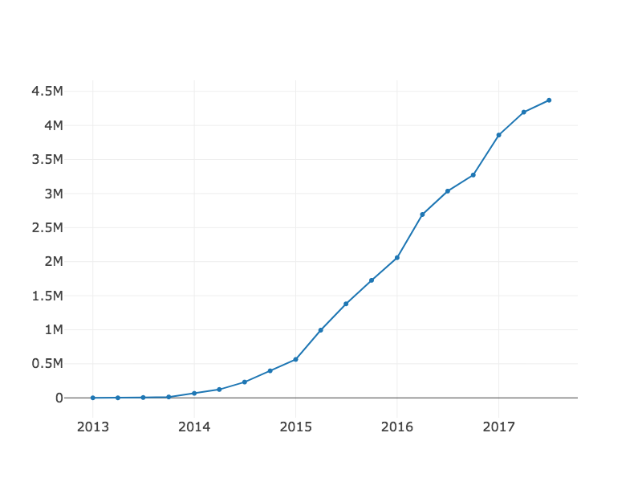
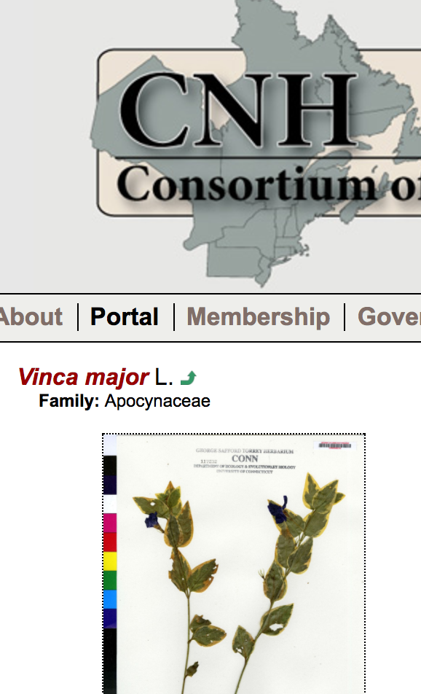

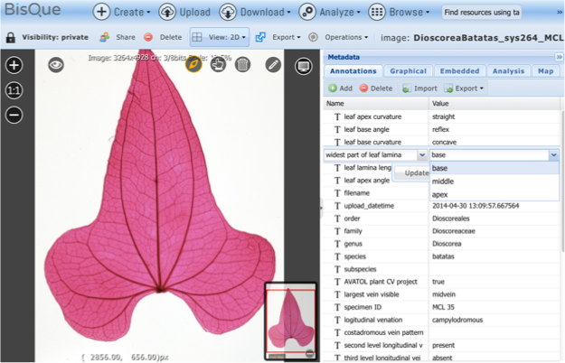
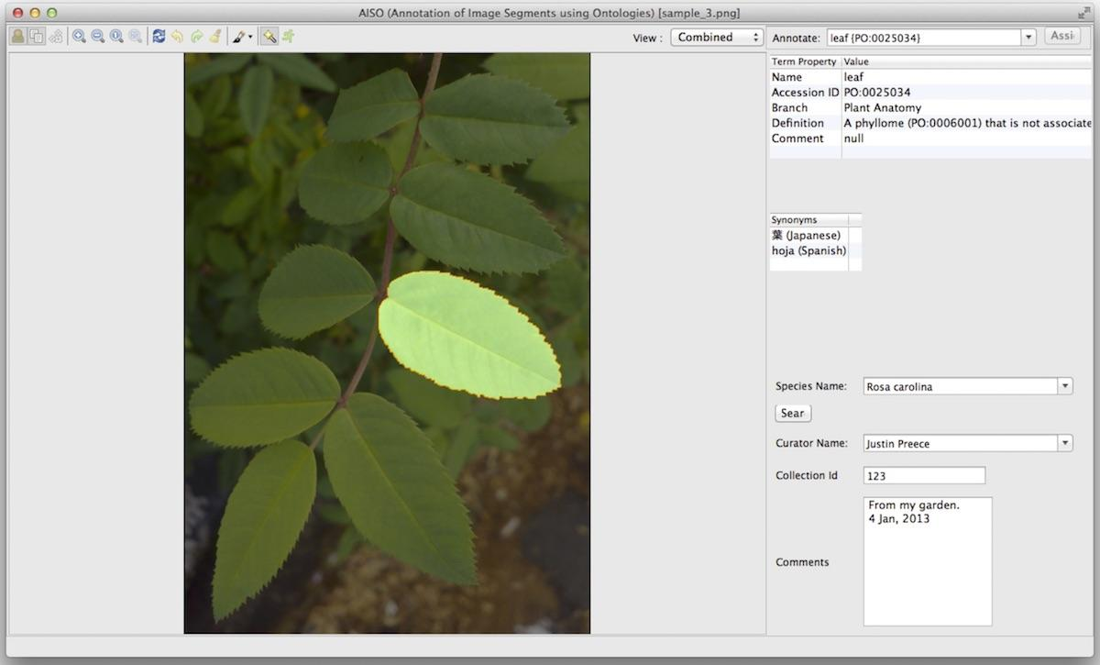
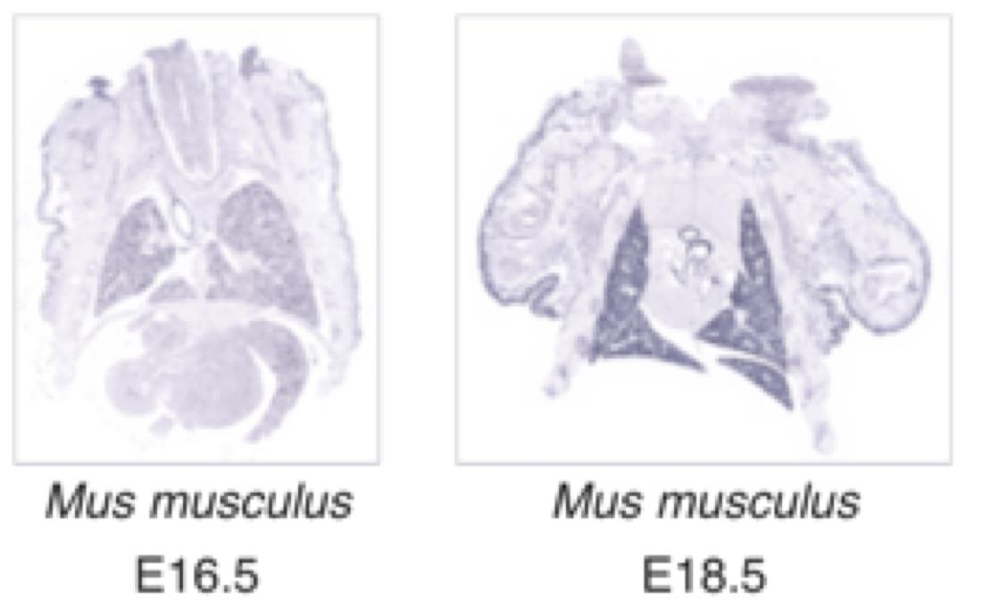
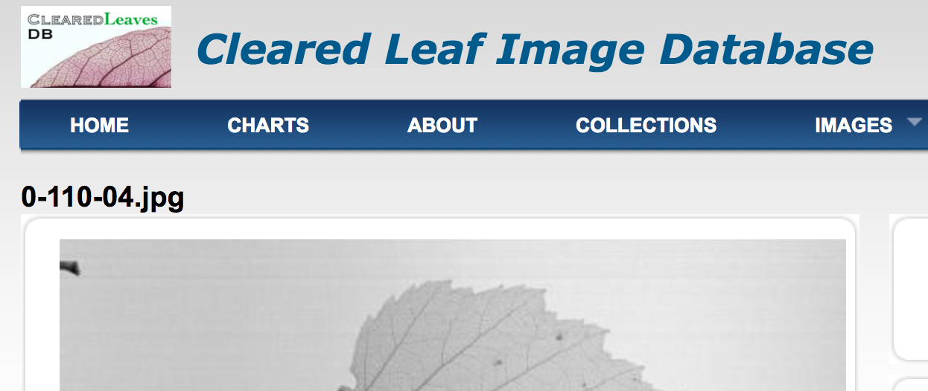
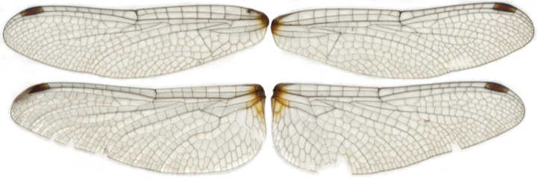

Imaging projects on CyVerse BisQue broaden over time
SERNEC
Number of Total Images in BisQue (millions)
AVATOL
NEVP/CNH
LungMap
AISO/PIA/C-ROP
Cleared Leaf DB
Cancer images
OdonataWeb
2013
2014
2015
2016
2017
Notes:
Early adopters were plant oriented with relatively small datasets: AVATOL Next Generation Phenomics for the Tree of Life, ClearedLeaf DB
Next wave of adopters were still plant focused, but broadened the volume of data (NEVP, SERNEC) and scope of work (AISO -- which later became PIA and is part of the CROP ontology project -- are using Bisque as a GUI for their segmentation and machine learning algorithms.
Newest users span disciplines, including dragon- and damsel flies, in situ hybridization of mouse brains, and cancer imaging storage.

Slide 16
Scaling Image Files and Metadata Management
NEVP SERNEC
5 years 2.5 years
18 herbaria 125 herbaria
1,468,867 image files 1,696,046 files
Southeast Regional Network of Expertise and Collections (SERNEC) adopted the NEVP workflow
10x more herbaria than NEVP
Scaled to same size in ½ amount of time
Notes:
Main points:
Solving a bottleneck for one group leads to empowering other groups
Metadata is as important as data (images)
Now other groups like OdonataWeb and LungMap are using Bisque for distributed image collection and management with their own workflows

Slide 17
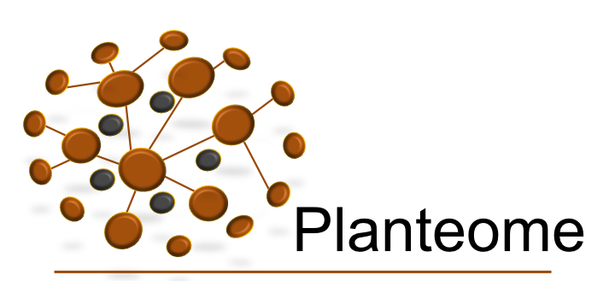

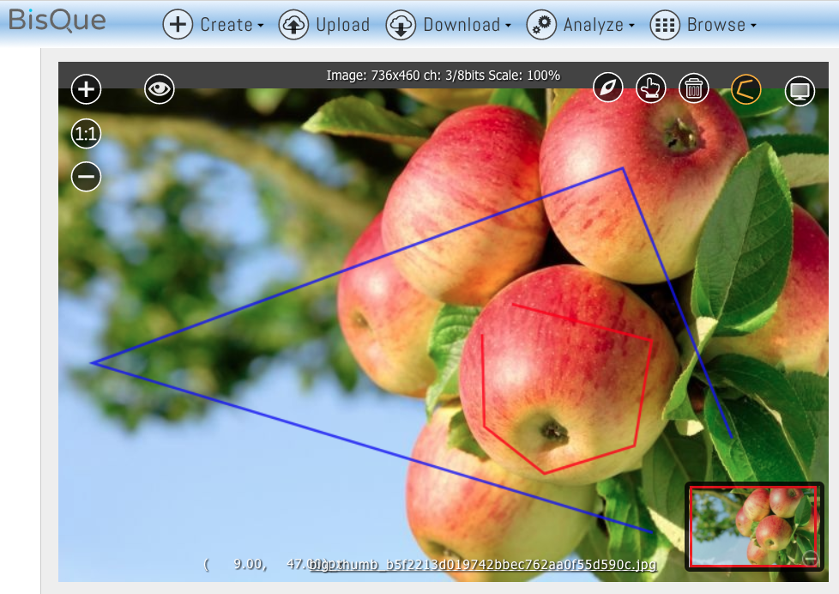
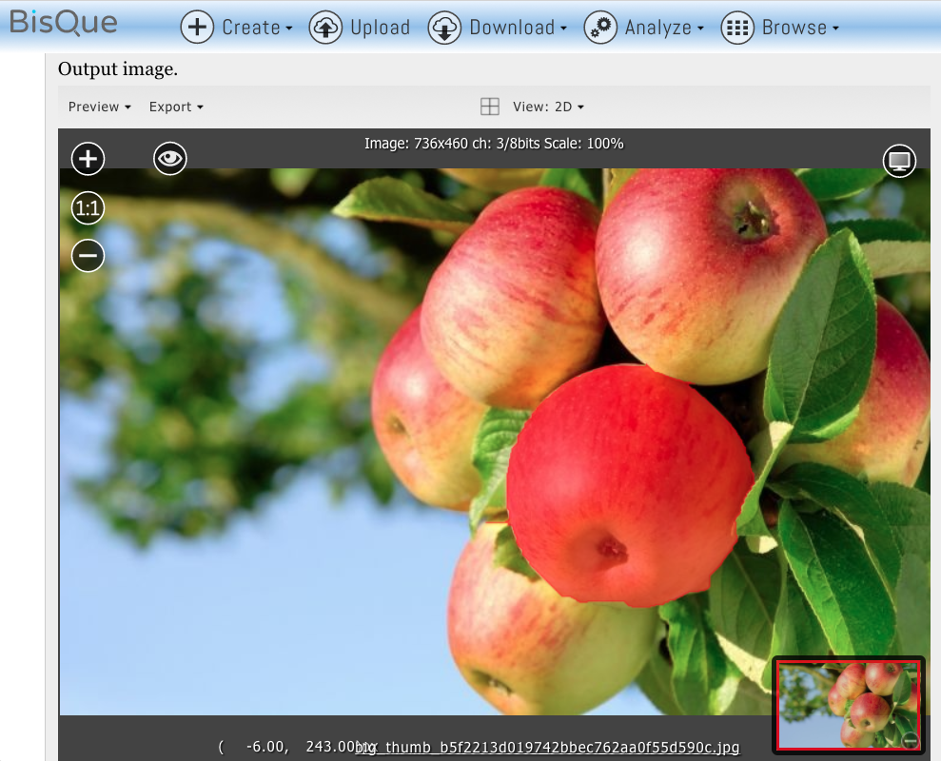
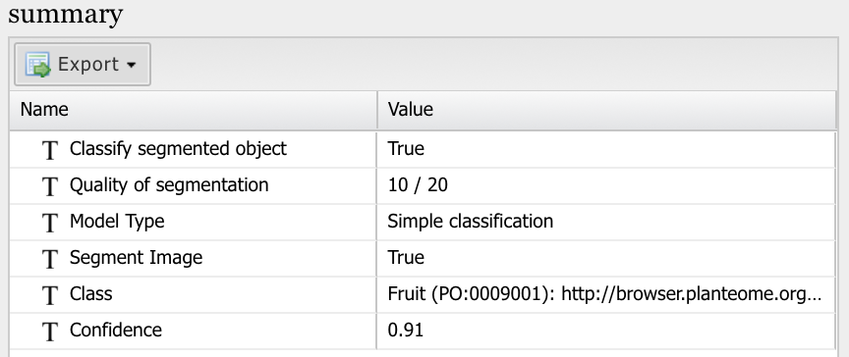
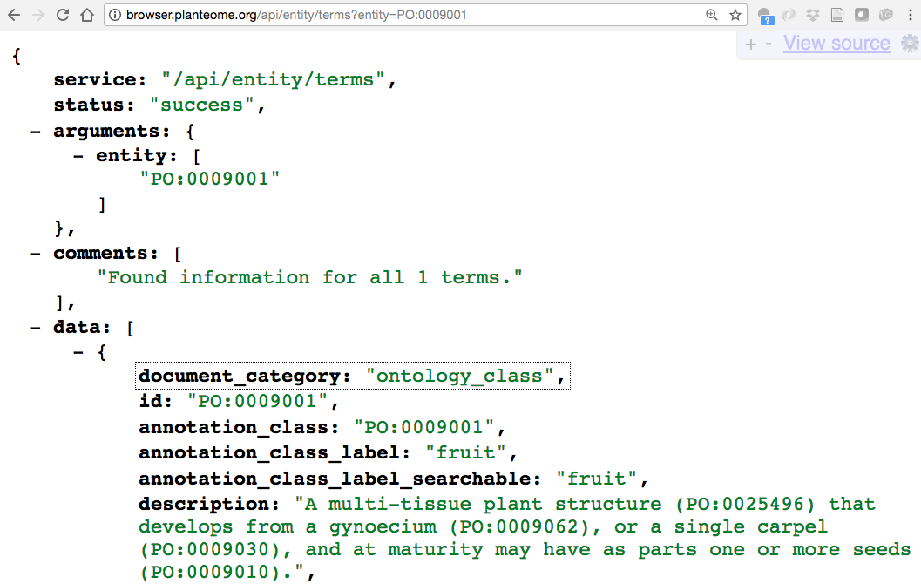
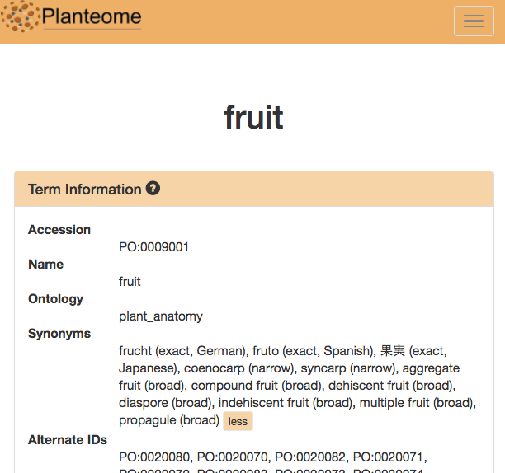
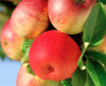



Planteome Image Analysis in BisQue
The Planteome Project: Reference ontologies, annotation resources, and analysis tools for plant research.
www.planteome.org
cyverse.planteome.org
Bisque Analysis Module (beta)
Segmentation
Dynamic Graph Cuts algorithm
Minimal user input: foreground & background markup
Classification
Deep-learning approach uses a network model trained on curated plant images
Can classify whole image or a portion of an image
In development: Ontology Integration, Annotation & Search
Associate classified images and image segments with ontology terms
Accommodate both user-contributed and automated annotation
Planteome Ontology API
Planteome Browser
Development: Dimitrios Trigkakis, PhD candidate, EECS; Justin Preece, Faculty Research Assistant, Jaiswal Lab
Supervision: Dr. Sinisa Todorovic (Dept. of Elec Engineering & Comp Sci), Dr. Pankaj Jaiswal (Botany & Plant Pathology)
Funding: NSF #1340112

Slide 18

Future Development: Cycle of Machine Learning and Metadata
Ontology used to describe image segments
Segmented image objects
BisQue
Cyverse
Data Store
Image objects shown in ontology

Slide 19
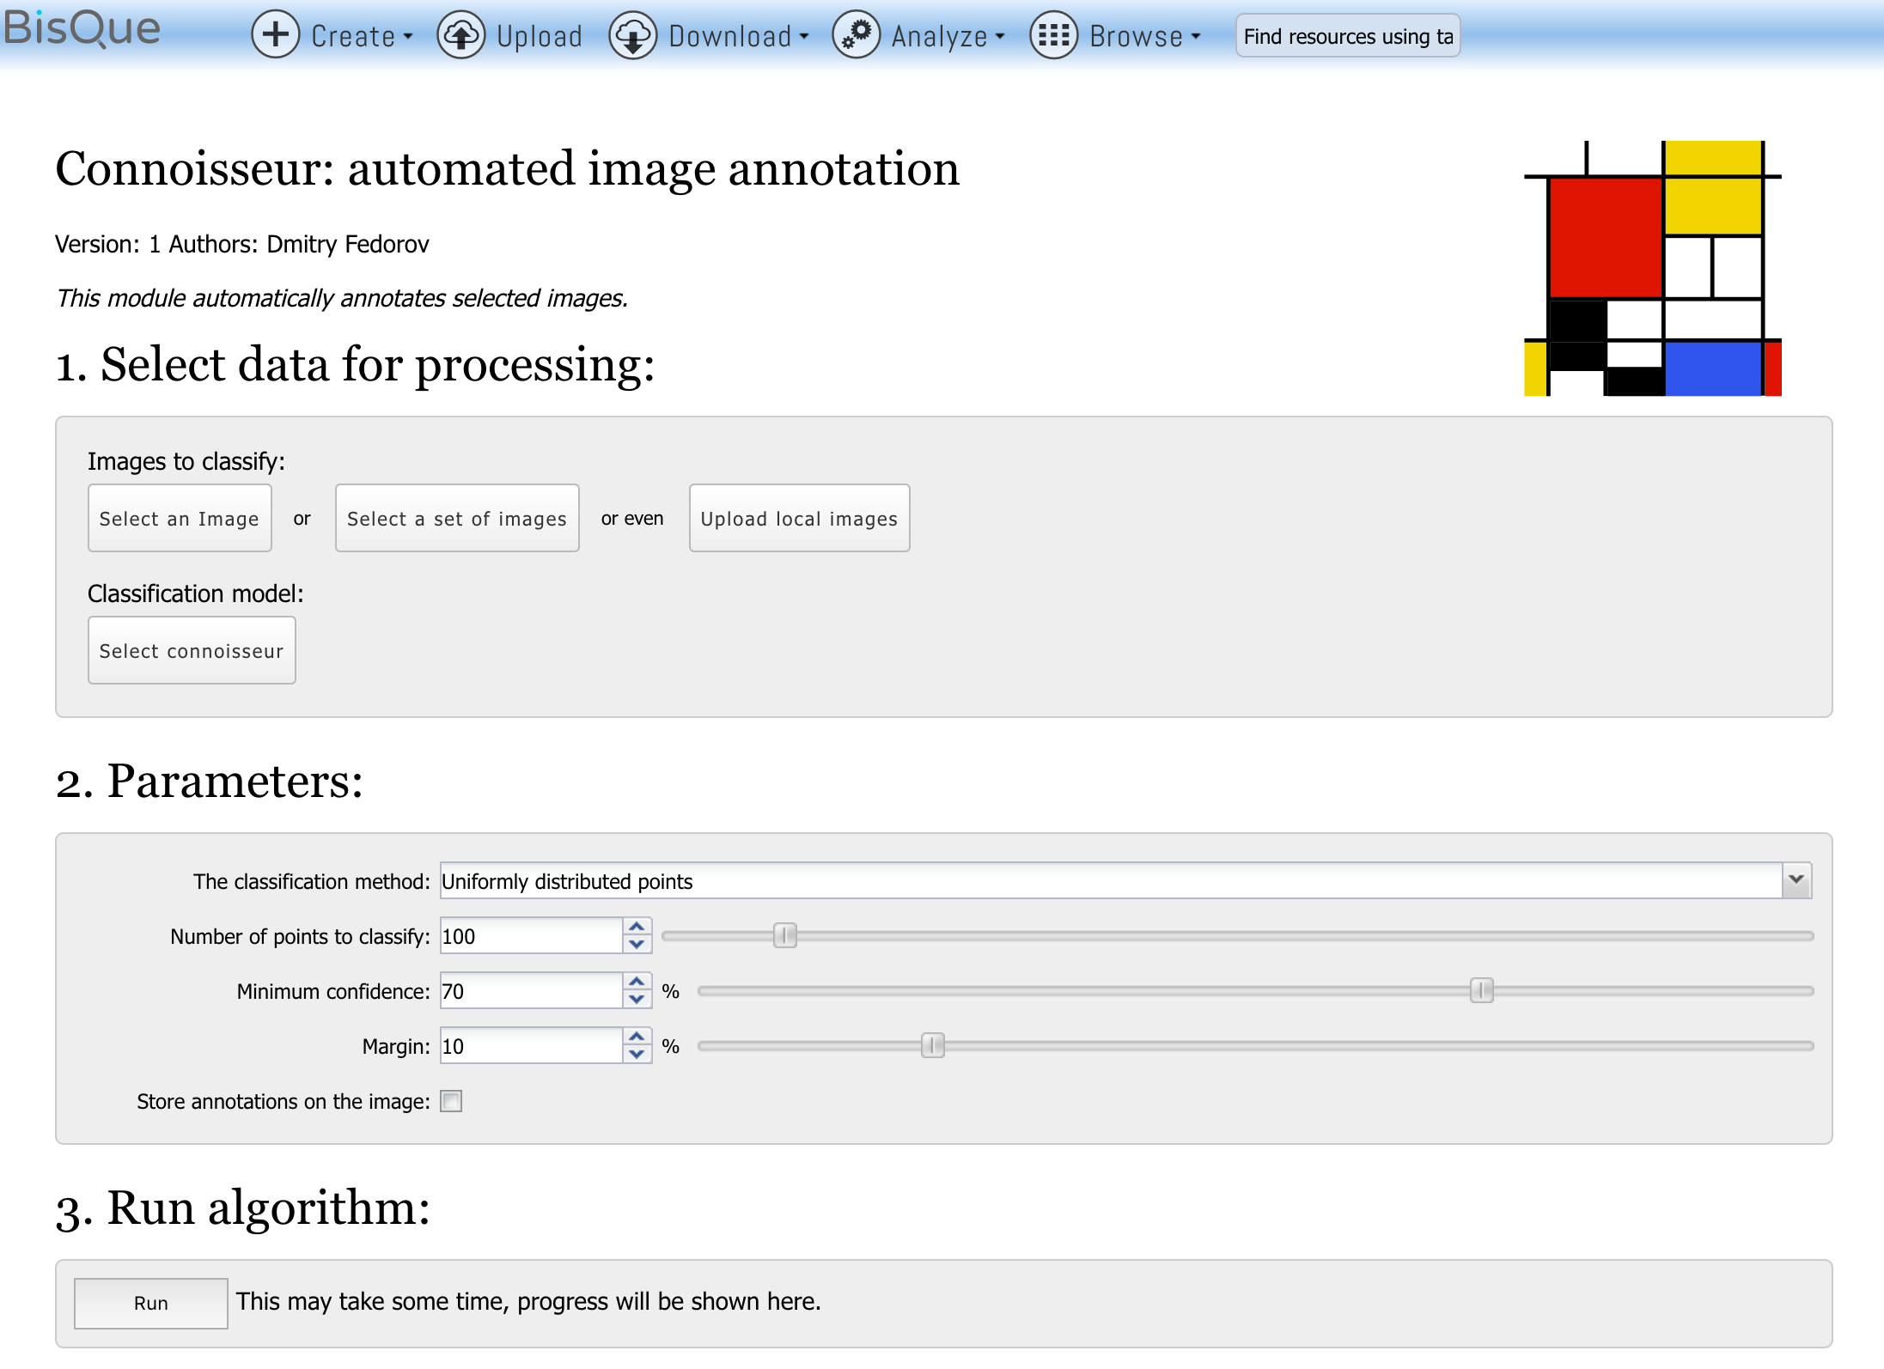
Democratization of Machine Learning

Slide 20
Training Made Simpler

Slide 21
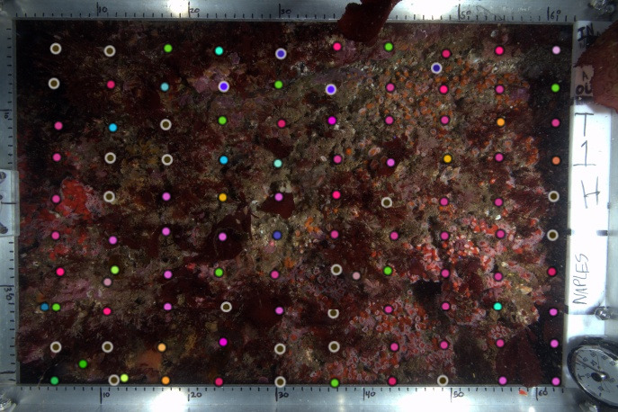

Slide 22
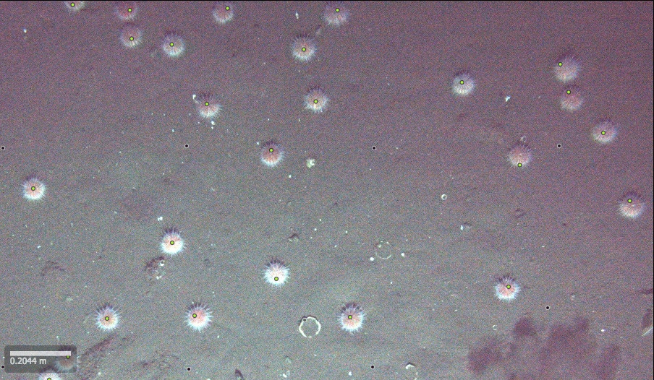

Slide 23





Transforming Science Through Data-driven Discovery
CyVerse is supported by the National Science Foundation under
Award No. DBI-0735191 and DBI-1265383.
Our 51,000+ Users
Executive Team
Parker Antin
Nirav Merchant
Eric Lyons
Matt Vaughn
Doreen Ware
Dave Micklos

Slide 26
Analysis Needs Going Forward
Novel data types and workflows
Data handling
New Execute Environments
Intermediate/Super Users

Slide 27
Novel Data Types and Workflows
Drone, satellite, GIS images
Machine learning models
New workflows needed
Geolocation
Stitching/Mosaic photos together
Point cloud 3D reconstruction
Machine learning feature recognition
Triage/sorting images based on features
Use Cases
GIS/Drone/Sattelite: Precision agriculture – daily decision making to reduce inputs
ML/Image triage: endangered animal conservation – identify locations with endangered animals from trail cameras, count individuals in that location, reduce time conservasionists spend looking at pictures, maximize time doing conservation

Slide 28
Data Handling
Petabytes and Exabytes of Data
Change the paradigm: move analysis to data sets
Subsetting of massive GIS datasets
Integrate with other data storage users know
S3/Drive/Dropbox

Slide 29
Executive Environment
Condor
Automatic (and configurable) distribution of CPU/Memory
Job queues
GPU
New server ordered
4 x NVIDIA 1080s
Initial investigation into GPU compute infrastructure
Training machine learning models
Large-scale image processing
Bring your own compute
Cloud computing
JetStream
AWS
Local HPC resources
Portal Me HPC

Slide 30
Intermediate/Power Users: Data Science Workbenches
Intermediate/Advanced Users need new kinds of ways to interact
APIs to build new tools
Data science workbenchs
Jupyter notebooks/Rstudio
Work in your preferred environment, languages, and libraries
Python, R, C++, Matlab, Spark, etc.
Select the tools you want to use on the fly
Pull tools from public, canonical repositories
GitHub
DockerHub/SingularityHub

